Slide 1
Getting Started in Office 365 with the Microsoft Graph API
Bernd Rickenberg
CTO and developer @ Pointwork

Slide 2

Introduction to Microsoft Graph API
1 - Intro to the Microsoft Graph API
2 - Getting Started
3 - SDKs and Code Samples
4 - Resources

Slide 3
1
Intro to the Microsoft Graph API

Slide 4
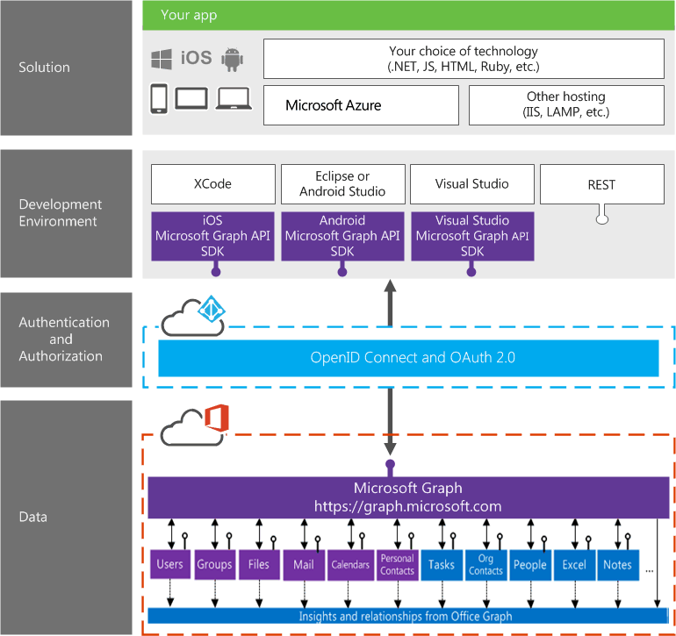
Building integration with Office 365
Notes:
Single resource that proxies multiple Microsoft services
Only one OAuth access token needed
Navigate across workloads and relationships logically

Slide 5








/groups
Shared with me
Shared with me
createdBy
createdBy
CONVERSATIONS
public
public
manager
directReports
directReports
directReports
directReports
EVENTS
EVENTS
modifiedBy
modifiedBy
FILES
FILES
memberOf
memberOf
GROUPS
GROUPS
createdBy
MESSAGES
FILES

Slide 6

Microsoft Graph Data
Active Directory
Users
profile
photo
direct reports
Groups
members
conversations
SharePoint
Sites
Lists
OneDrive
Files
upload
download
copy
versions
Outlook
Mail
messages
folders
send message
Calendar
events
find times
Excel
OneNote
Planner
Contacts
Directory
Webhooks
Beta
Teams
Insights
Project Rome
Devices
Activities
Intune
Reports
…and much more

Slide 7

Microsoft Graph Capabilities
Auth
Credentials
Work/School
Personal
OAuth scopes
User
App
OData
Filter
Order
Pagination
SDKs
.NET
JS
PHP
Android
iOS
Query patterns
Web hooks
Delta
Extensions
Batching
Other
Swagger
Visual Studio Tooling
Compliance

Slide 8
2
Getting Started

Slide 9
Demo – Docs https://graph.microsoft.com > documentation
Notes:
v1.0 documentation for users (methods, properties, relationships)
Changelog
Known Issues
Authentication
Not always update to date – OneDrive download formats is missing https://docs.microsoft.com/en-us/onedrive/developer/rest-api/api/driveitem_get_content_format

Slide 10
Demo – Graph Explorer https://graph.microsoft.com > graph explorer
Notes:
Me endpoint v1.0 vs. Beta
Login with bernd@M365x895555.onmicrosoft.com
https://graph.microsoft.com/v1.0/me/
https://graph.microsoft.com/v1.0/me?$select=displayName
https://graph.microsoft.com/v1.0/me/joinedGroups
https://graph.microsoft.com/beta/me/joinedTeams
https://graph.microsoft.com/v1.0/groups/bdd1e45b-a0ea-4bc1-b8ab-9e8bd50d4709
https://graph.microsoft.com/v1.0/groups/bdd1e45b-a0ea-4bc1-b8ab-9e8bd50d4709/events
https://graph.microsoft.com/v1.0/groups/bdd1e45b-a0ea-4bc1-b8ab-9e8bd50d4709/members
https://graph.microsoft.com/v1.0/groups/bdd1e45b-a0ea-4bc1-b8ab-9e8bd50d4709/drive
https://graph.microsoft.com/v1.0/groups/bdd1e45b-a0ea-4bc1-b8ab-9e8bd50d4709/drive/root/children
https://graph.microsoft.com/v1.0/groups/bdd1e45b-a0ea-4bc1-b8ab-9e8bd50d4709/drive/items/01E63P7DH7NEOIVADZI5HYGYEY7ESWV3BH
https://graph.microsoft.com/v1.0/groups/bdd1e45b-a0ea-4bc1-b8ab-9e8bd50d4709/drive/items/01E63P7DH7NEOIVADZI5HYGYEY7ESWV3BH/content Grab redirect URL from Location response header and copy&paste into browser window
https://graph.microsoft.com/v1.0/groups/ Cannot enumerate sitesbdd1e45b-a0ea-4bc1-b8ab-9e8bd50d4709/drive/items/01E63P7DH7NEOIVADZI5HYGYEY7ESWV3BH/content?format=pdf Grab redirect URL from Location response header and copy&paste into browser window
https://graph.microsoft.com/v1.0/groups/bdd1e45b-a0ea-4bc1-b8ab-9e8bd50d4709/sites

Slide 11

Me
GET /me/messages
GET /me/events
GET /me/drive
GET /me/joinedGroups
GET /me/joinedTeams
Documents
Calendar
Email
Groups
Teams

Slide 12

Groups
GET /groups/{id}/events
GET /groups/{id}/members
GET /groups/{id}/drive
GET /groups/{id}/drive/items
GET /groups/{id}/drive/items/{id}/content
Documents
Calendar
Members

Slide 13
Demo - Quick Start https://graph.microsoft.com > quick start
Notes:
Create UWP
Login with bernd@M365x895555.onmicrosoft.com
Download sample

Slide 14
3
SDKS and Code samples

Slide 15
Demo - .NET SDK https://graph.microsoft.com > quick start
Notes:
New Console Application
Add MSAL from NuGet - Microsoft.Identity.Client (pre-release)
Add Graph from NuGet - Microsoft.Graph
Grab clientId and AuthenticationHelper class from UWP example

Slide 16
4
Resources

Slide 17

Resources
Documentation, samples and more:
https://graph.microsoft.com/
Stack overflow:
[Microsoft-Graph] and [Office-365]
Twitter:
#MicrosoftGraph and #Office365dev

Slide 18

Summary
New endpoint for AAD provides converged authentication for personal accounts as well as work or school accounts.
New MSAL libraries simplify applications that have multiple platform components

Slide 19
Thank you

